Slide 1


INF 154
PRACTICAL 1
2023
‹#›

Slide 2
At the end this practical you should be able…
To set up your Windows Form project.
Add the following controls; buttons, labels and textboxes.
Edit the properties of buttons, labels and textboxes.
Create a basic program using buttons, labels and textboxes.
Investigate the meaning of keywords and learning how to understand the language.
You will be taken through the process of building your Windows Forms Apps and get some hands on experience with C#.
‹#›

Slide 3

What are we going to do?
Prac 1a: Work with buttons and position of controls
Prac 1b: Work with buttons and labels
Prac 1c: Work with buttons and textboxes and labels
Prac 1d: Use all the work that has been previously covered
‹#›

Slide 4

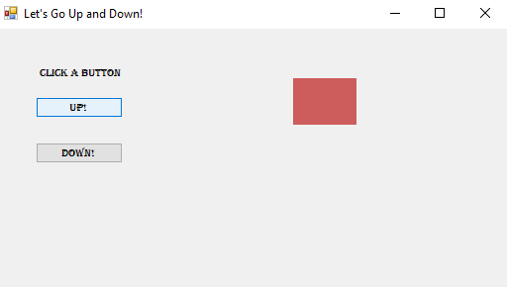

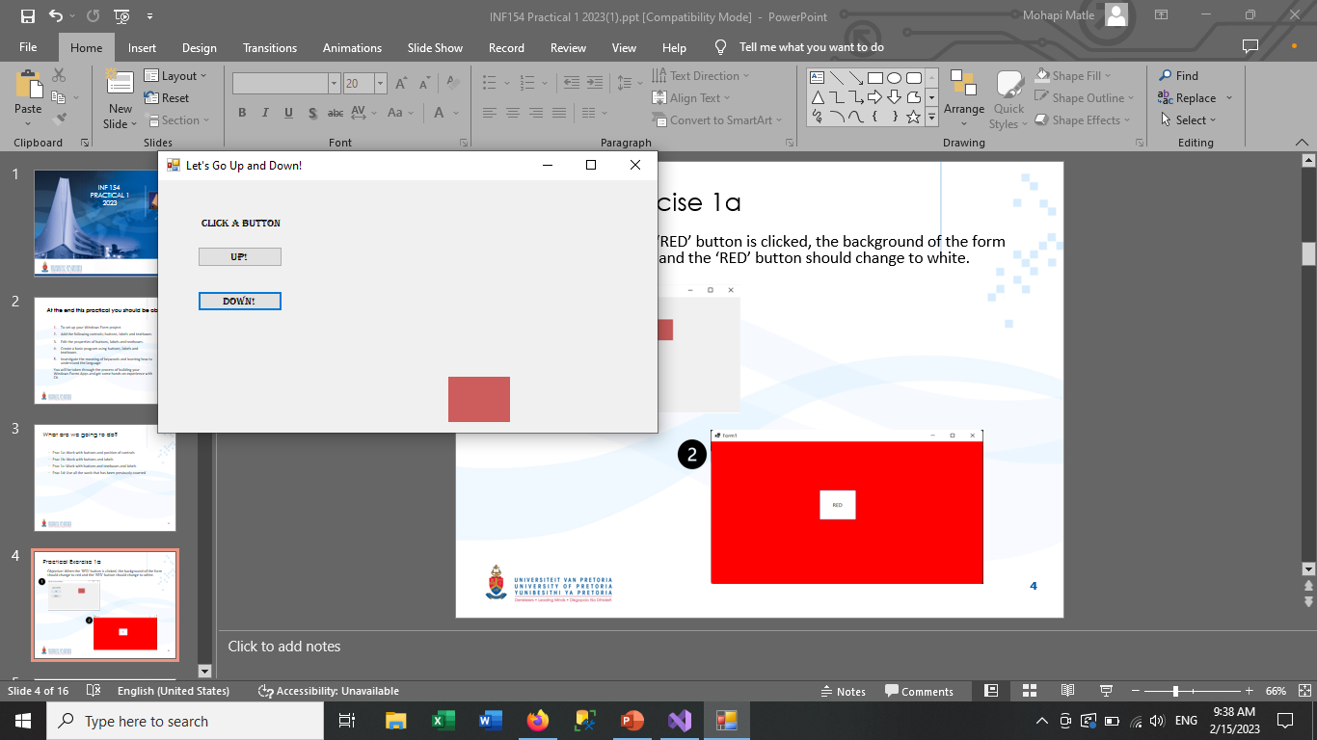
Practical Exercise 1a
Objective: When the ‘UP!’ button is clicked, the red square should move up and when the ‘DOWN!’ button is clicked, the red square should move down.
‹#›

Slide 5
Practical Exercise 1a
Designing the form:
You can either double click on the button and it will be added to your form in the top left hand corner OR you can drag and drop the button.
To change the dimensions of the button, click on one of the squares surrounding the button and drag.
To change the name of the button that will be displayed to the user on the GUI (graphical user interface), navigate to the ‘Properties’ tab and find the row that is labelled ‘Text’. Change the name to ‘UP!’. Repeat Step 1 – 3 for the “DOWN!” as well.
To change the name of the button that will be used when coding, navigate to the section ‘Design’ within the ‘Properties’ tab and find the row ‘(Name)’. Name the button, btnUp (for the up button) and btnDown (for the down button).
Drag or double click the panel to bring it onto the form. Now navigate to the ‘Appearance’ section of the ‘Properties’ tab and find the (BackColor) row. Click on the down arrow, click on the ‘Web’ tab and select the ‘IndianRed’ colour.
‹#›

Slide 6
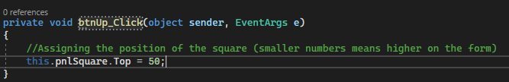
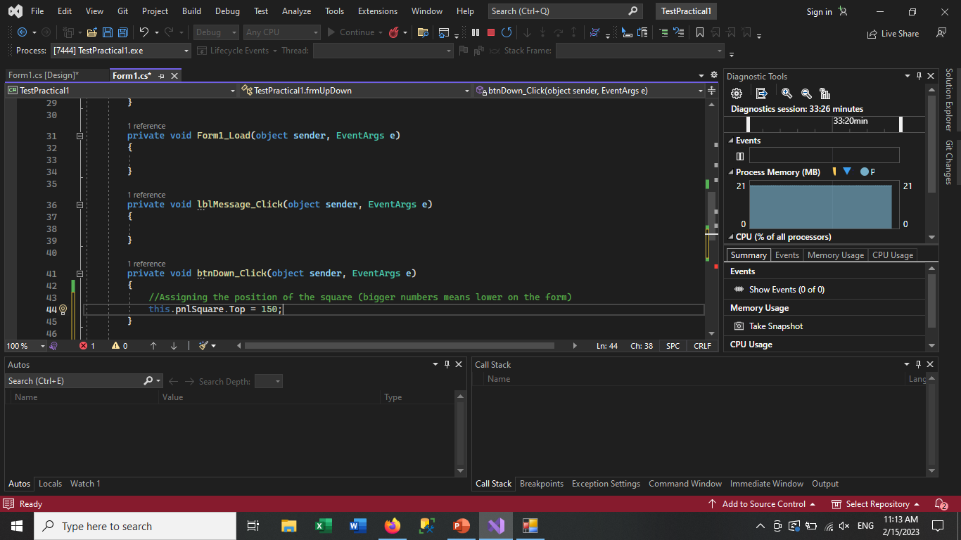
Practical Exercise 1a
The code:
Double-click on the ‘UP!’ button to open its click event handler and add the following statement between the brackets:
- Double-click on the ‘DOWN!’ button to open its click event handler and add the following statement between the brackets:
‹#›

Slide 7

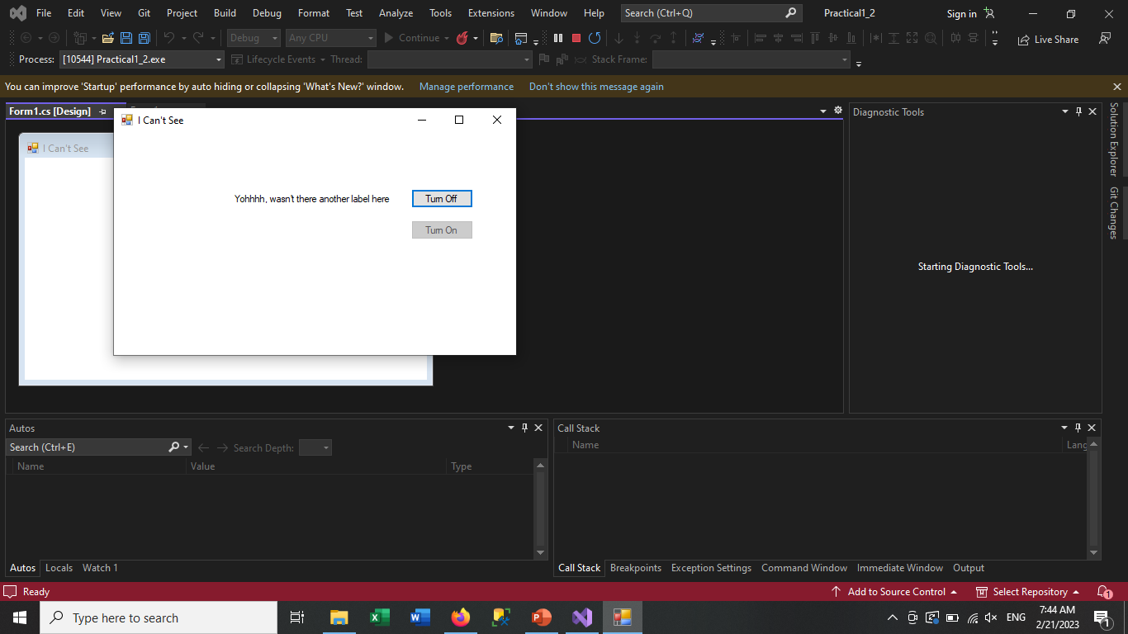

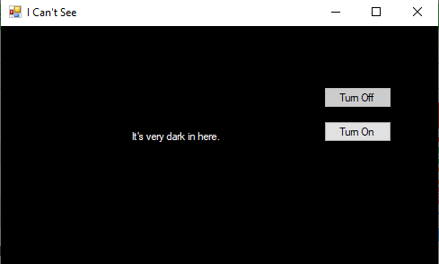
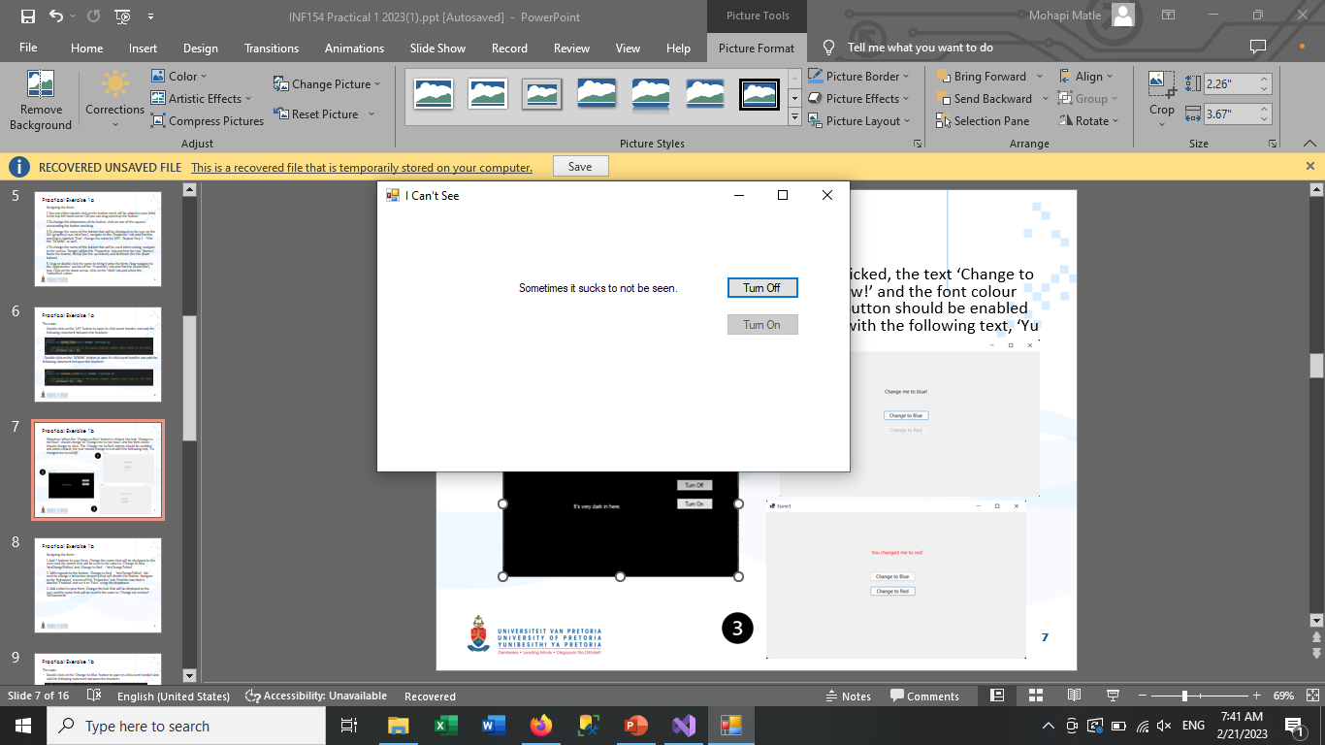

Practical Exercise 1b
Objective: When the “Turn Off” button is clicked, the text “It’s very dark in here” should appear while the “Yohhhhh, wasn’t there another label here” text will disappear and the button will be disabled. The background will also change to black. When the “Turn On” button is clicked, the text “Sometimes it sucks to not be seen” will appear and while the other text will disappear and the button will be disabled.
The background will return back
to white.
‹#›

Slide 8
Practical Exercise 1b
Designing the form:
Add 2 buttons to your form. Change the name that will be displayed to the users and the names that will be used in the code to; ‘Turn Off’ – ‘btnTurnOff’ and ‘Turn On’ – ‘btnTurnOn’.
With regards to the button, ‘Turn Off’ – ‘btnTurnOff’. We need to change a behaviour property that will disable the button. Navigate to the ‘Behaviour’ section of the ‘Properties’ tab. Find the row that is labelled ‘Enabled’ and set it to ‘False’ using the dropdown.
Add two labels to your form. Change the text that will be displayed to the user and the name that will be used in the code to; ‘Yohhhhhhh, wasn’t there another label here’ – ‘lblBlack’. For the second label, you can leave the Text property as is. Just change the Name property to ‘lblWhite’.
Change the lblWhite’s ForeColor property to ‘White’ which can be found in under the Web section of colours.
‹#›

Slide 9
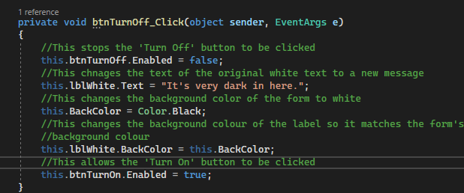
Practical Exercise 1b
The code:
Double-click on the ‘Turn Off’ button to open its click event handler and add the following statement between the brackets:
‹#›

Slide 10
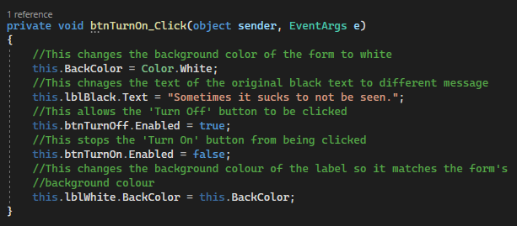
Practical Exercise 1b
The code:
- Double-click on the ‘Turn On’ button to open its click event handler and add the following statement between the brackets:
‹#›

Slide 11
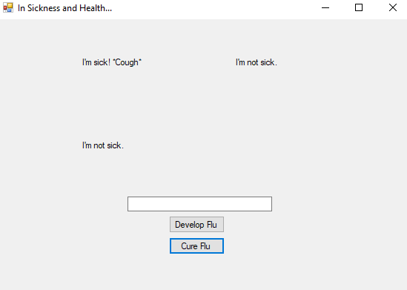
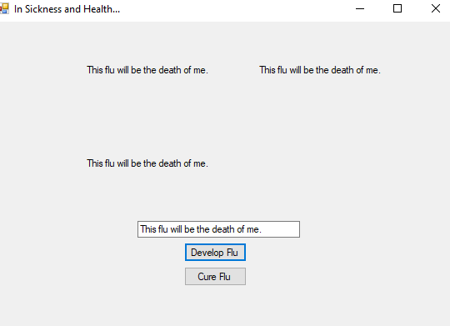
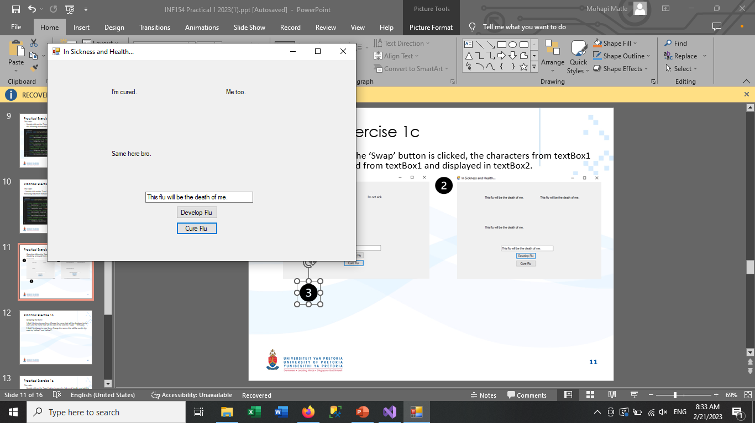
Practical Exercise 1c
Objective: When the ‘Swap’ button is clicked, the characters from textBox1 should be removed from textBox1 and displayed in textBox2.
‹#›

Slide 12
Practical Exercise 1c
Designing the form:
Add 2 button to your form. Change the name that will be displayed to the users and the name that will be used in the code to; ‘Develop Flu’ – ‘btnFlu’ and ‘Cure Flu’ – btnCure.
Add a textbox to your form. Change the Name property that will be used in the code to; ‘txtBoxSentence’.
Add 3 labels to the form. Change the Name and the Text properties that will be displayed as follows: ‘I’m sick. *Cough*’ – ‘lblPatientZero’, ‘I’m not sick’ – ‘lblPatientOne’ and ‘I’m not sick’ – ‘lblPatientTwo’
‹#›

Slide 13
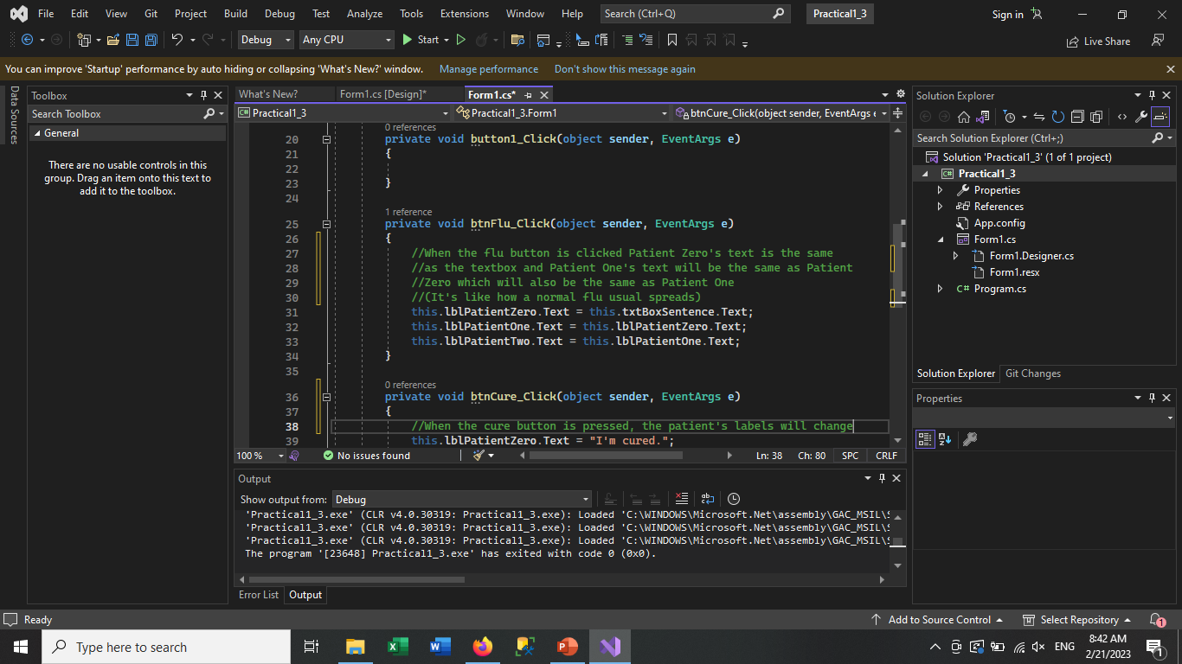
Practical Exercise 1c
The code:
Double-click on the ‘Swap’ button to open its click event handler and add the following statement between the brackets:
‹#›

Slide 14
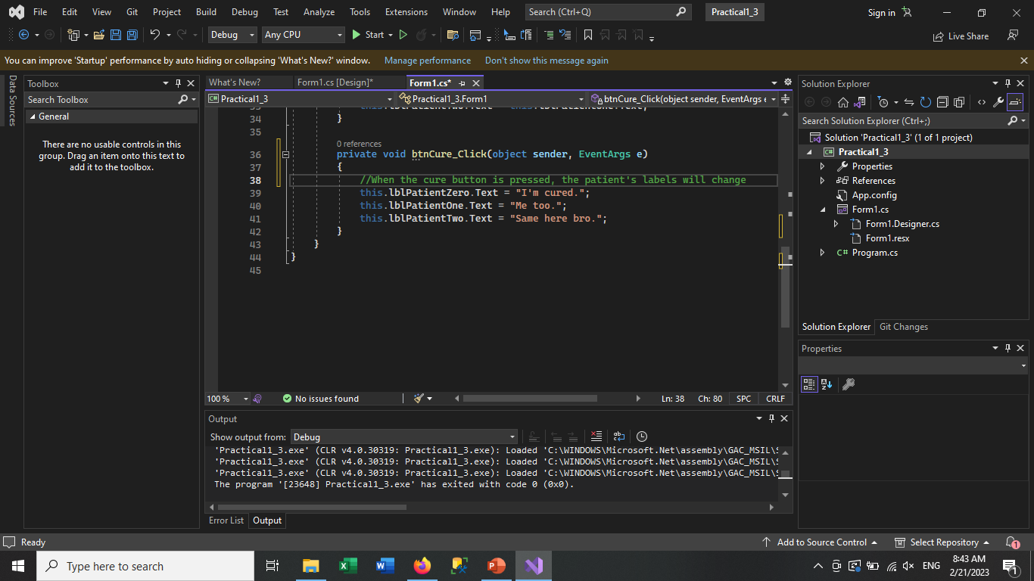
Practical Exercise 1c
The code:
Double-click on the ‘Cure’ button to open its click event handler and add the following statement between the brackets:
‹#›

Slide 15
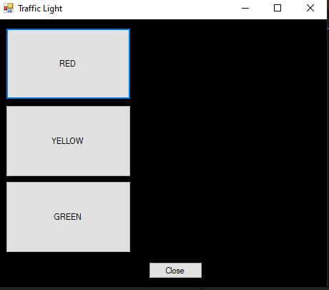
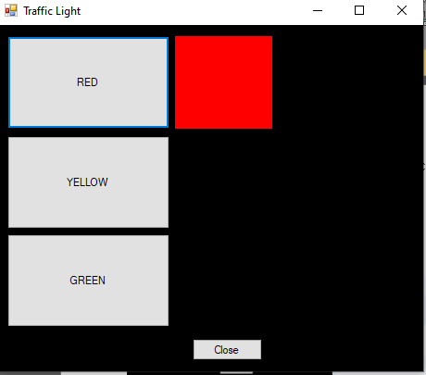
Practical Exercise 1d
Objective: When a button is clicked, a block should appear and change to that colour. (Like a traffic light).
‹#›

Slide 16
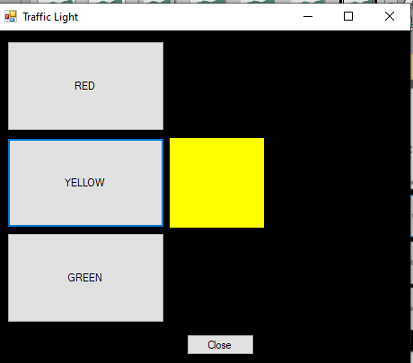
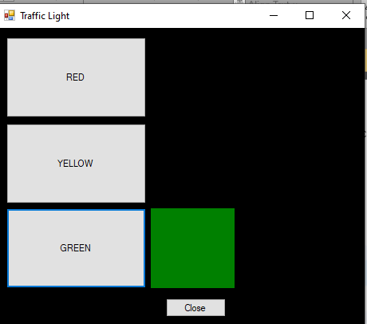
Practical Exercise 1d
Objective: When a button is clicked, a block should appear and change to that colour. (Like a traffic light).
‹#›

Slide 17
Practical Exercise 1d
Notes and tips:
You should use a panel/s in order to create the traffic light simulation.
When you click the ‘close’ button, the program will exit like when you click the red ‘x’ button.
TIP: Look on the internet on how to close a form with code.
‹#›

Slide 18
Practical 1 Submission
Submit your Practical 1d project on ClickUP as Follows:
Due Date: 6 March 2023 - 08:30.
Name your project, “INF154Prac” and compress (zip folder) your project.
Submit it under the Practical 1 submission link.
‹#›

